Slide 1

The Battle of Neighborhood
Data Science Capstone Project
By: Aditya Prakash
Date: 18th Feb 2021

Slide 2

CONTEXT:
Introduction
Data
Methodology
Results and discussion
Conclusion

Slide 3

INTRODUCTION
Would you like to find a perfect location for business living or traveling, using just a few mouse clicks?

Slide 4

MAKIBO LTD CAN HELP YOU!
We have a special application, which will help you to find a perfect area for your goals due some moments, even accelerator needs more time than you with us!

Slide 5
DATA
Wikipedia helps to get Postal Code, Borough and Neighborhood in Toronto
Geospatial data for Toronto contains the geographical coordinates of each postal code
Foursquare API allows to obtain the data on what venues are located at each neighborhood
Random user data, with a random number (from 1 to 10) of preferences to check, how our system works

Slide 6
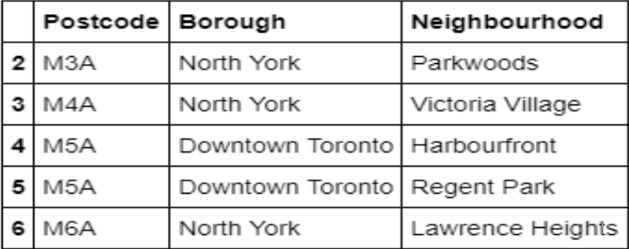
METHODOLOGY:
Pandas library to scrap the table from HTML page

Slide 7
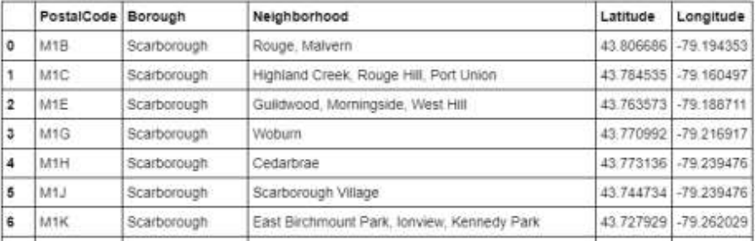
METHODOLOGY:
Geospatial data for Toronto contains the geographical coordinates of each postal code

Slide 8
METHODOLOGY:
Foursquare API allows to obtain the data on what venues are located at each neighborhood
Apply OneHot encode to get a new table with the neighborhood as the index and percentage of each category available in that neighborhood

Slide 9
METHODOLOGY:
Random User – Generate a random User to use for a test of the system
select a random number from 1 to 10 to represent the amount of categories selected by the user
create a table with the categories as the columns and one row, where the values are 1 if the user has that category in his list and 0 for vice versa

Slide 10
METHODOLOGY:
Recommendation system
Multiply the user profile with the table that has the neighborhood and the weight of each category
Result is a matrix with the score of each neighborhood
The higher score, the better the neighborhood fit the user interest

Slide 11
METHODOLOGY:
Recommendation system
Multiply the user profile with the table that has the neighborhood and the weight of each category
Result is a matrix with the score of each neighborhood
The higher score, the better the neighborhood fit the user interest

Slide 12
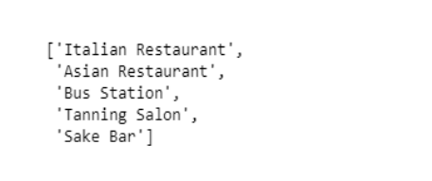
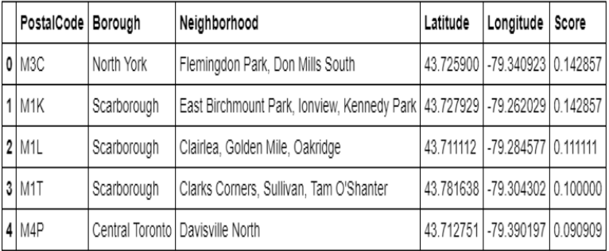
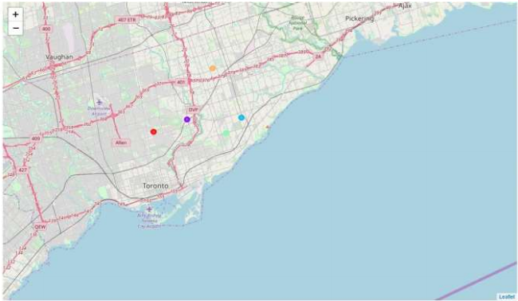
RESULTS AND DISCUSSION
In this prototype we generated some random categories for our user

Slide 13
RESULTS AND DISCUSSION
2 best neighborhoods for our user are “North York Flemingdon Park, Don Mills South” and “East Birchmount Park, Ionview, Kennedy Park”
Difference of the score amount the 5 neighborhoods is not big. A probable reason is that categories, which our user chose are more or less common, they don’t include anything extraordinary as “Airport Food Court”.

Slide 14

CONCLUSION:
This is a sample content-based recommendation system that still need to be improved.
The data and algorithm need more date and accuracy, especially for some small towns with a few venues.
There are more parameters, which could be use for the search, as distance to the work place, bus station and etc.

Slide 15

THANK YOU!
Aditya Prakash
Phone
9284703012
Email
adityaprakash.2009@gmail.com

